Slide 1
operating System Resource Management in a Multi-User Linux-Based Server Environment
File Sharing, Device Access & Kernel Interaction
CSA0401-OPERATING SYSTEMS
Presented By:
A. Dekkshitha (192572133)
Guided by:
Dr. J. Ruby Elizabeth

Slide 2

Introduction - Multi-User Linux Server
Linux supports multiple users simultaneously.
Users can share files and access system resources.
The Operating System manages hardware and software resources efficiently.
Ensures security, fairness, and system stability.

Slide 3
Scenario Overview
Server Environment:
Example:
Multiple users connected through SSH
Shared project folders
Shared printer
Network storage
USB devices
Multiple running applications
OS Responsibilities:
Resource allocation
User authentication
File protection
Device management

Slide 4
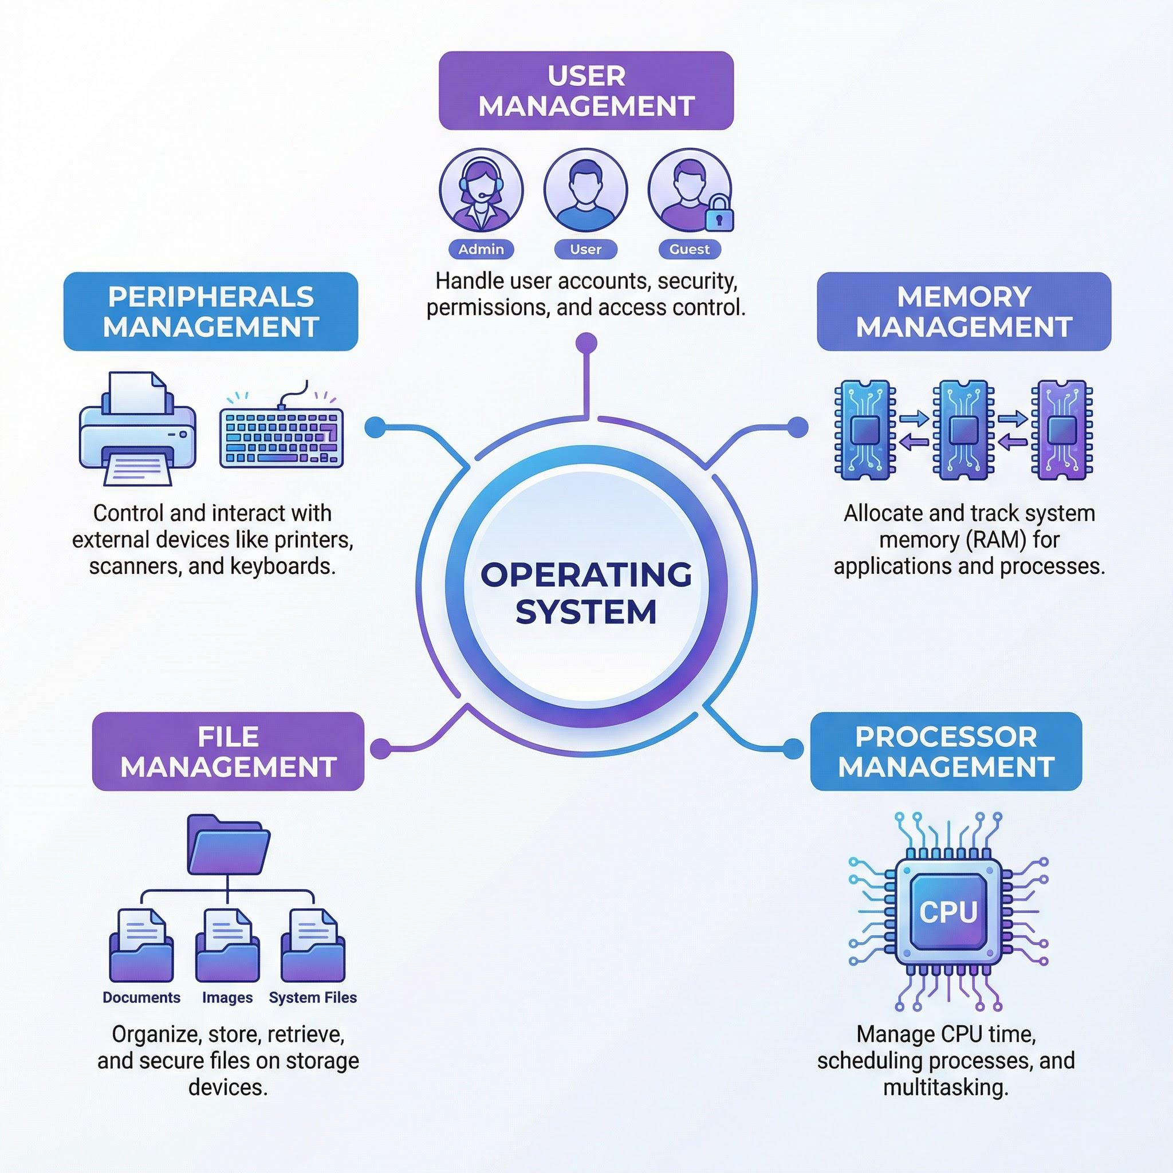
OS Functions in Resource Management
Major Resource Management Functions:
Process Management
CPU Scheduling
Memory Management
File System Management
Device Management
Security and Protection

Slide 5
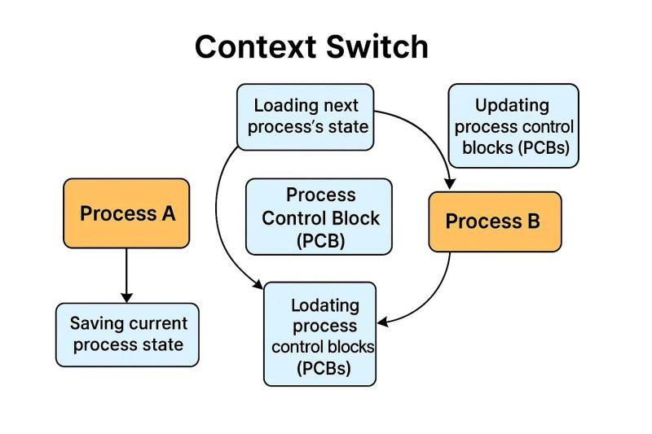
Process and CPU Management
Process Management:
Creates and terminates processes
Performs context switching
Handles multitasking
CPU Scheduling:
Shares CPU among users
Prioritizes processes
Improves response time
Linux Scheduler:
Completely Fair Scheduler (CFS)

Slide 6
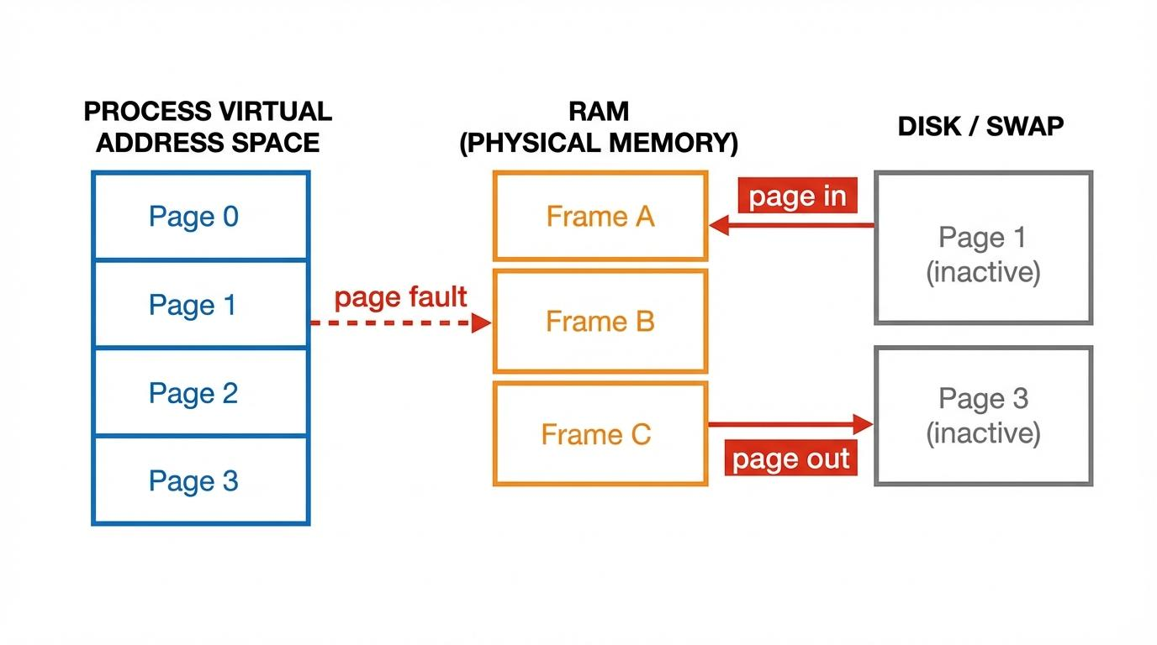
Memory and File Management
Memory Management:
Allocates RAM
Virtual Memory
Paging
Memory Protection
File System Management:
Organizes files and directories
Access permissions
Ownership
Disk space allocation

Slide 7
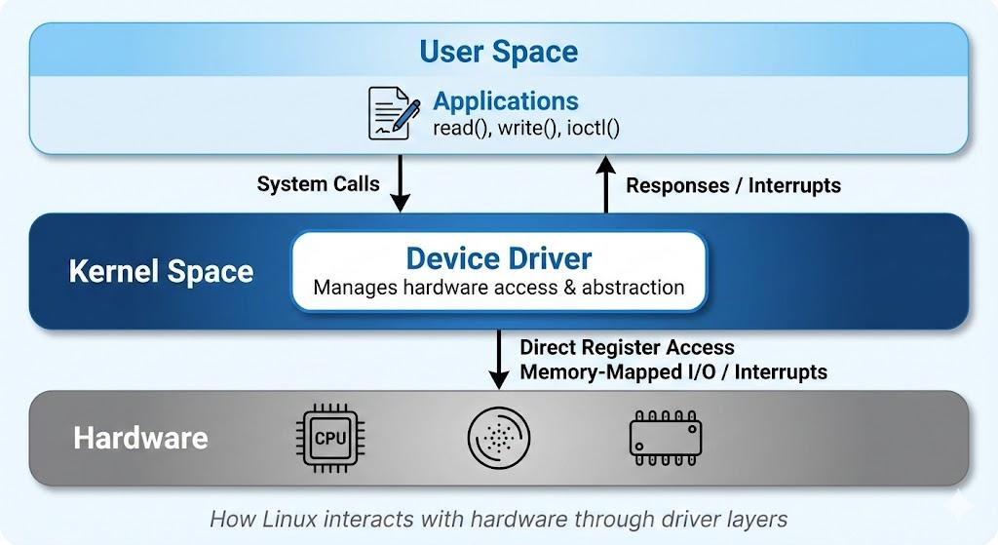
Device Management
Linux treats devices as files.
Examples:
Keyboard
Hard Disk
USB Drive
Network Interface
Responsibilities:
Device Drivers
Buffering
Interrupt Handling
Input/Output Control

Slide 8
File System Calls
System Call | Purpose
open() | Open file
read() | Read data
write() | Write data
close() | Close file
lseek() | Move file pointer
stat() | Get file information
chmod() | Change permissions
unlink() | Delete file

Slide 9
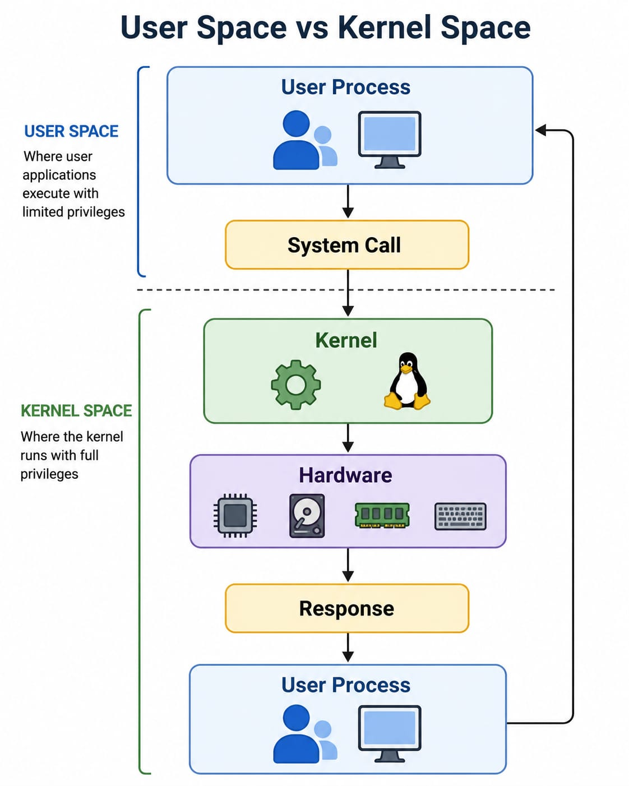
Interaction Between User Processes and Kernel
Steps:
User application requests service.
System call enters kernel mode.
Kernel performs operation.
Result returned to application.

Slide 10
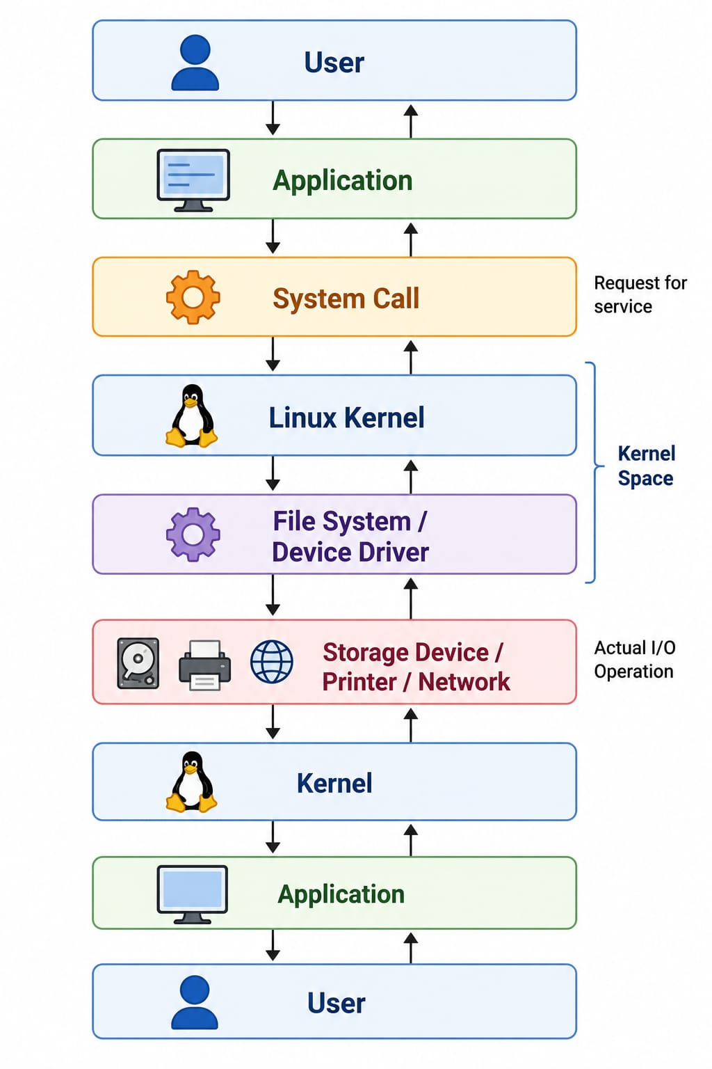
Complete Working Flow

Slide 11
Advantages of Linux Resource Management
Efficient multitasking
Secure multi-user access
Reliable file sharing
Better hardware utilization
Process isolation
Stable and scalable
High performance
Open-source flexibility

Slide 12

Conclusion
Linux efficiently manages CPU, memory, files, and devices.
System calls act as the communication bridge between applications and the kernel.
Kernel ensures secure resource allocation and hardware access.
Multi-user support makes Linux ideal for enterprise servers and cloud environments.

Slide 13


